Slide 1
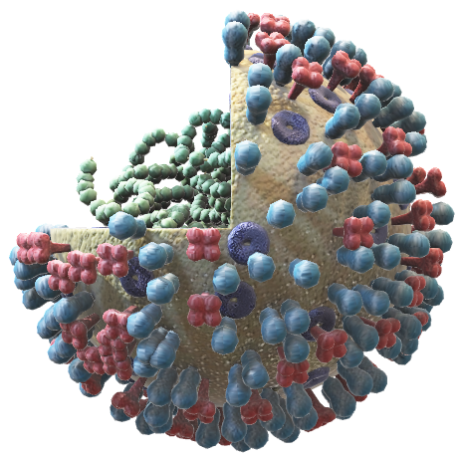
Risk Prediction or Risky Predictions? Evaluating Zhou et al.’s COVID-19 Model
Examining the Strengths, Weaknesses, and Reliability of a COVID-19 Risk Model

Slide 2






Outline
Why was this study conducted, and why does it matter?
How was the model developed?
Study Background
Methods
Findings
Strengths
Weaknesses
Overall Impression
What did the model predict, and how well did it perform?
What worked well? Key methodological strengths.
Limitations, gaps, and areas for improvement.
Are the results reliable? What are the takeaways?

Slide 3
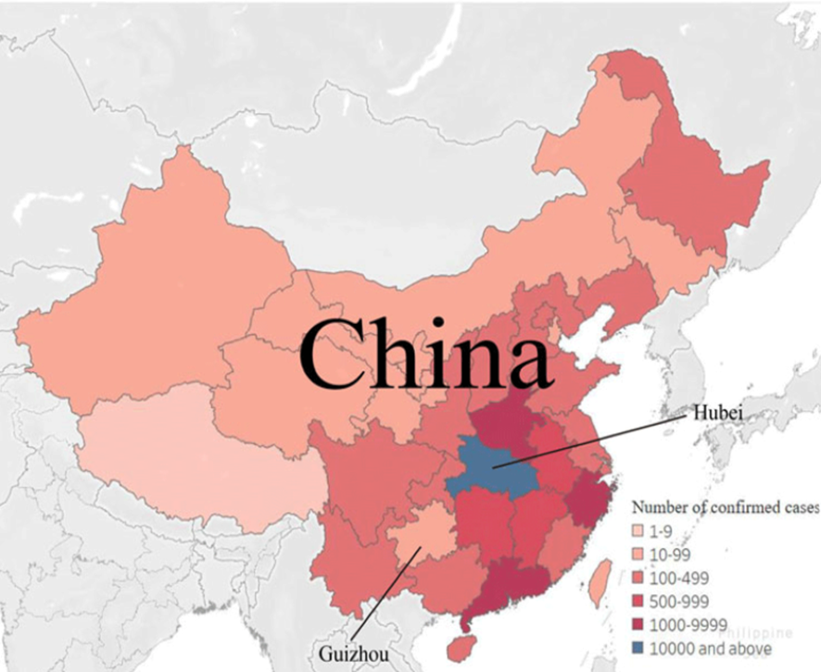
Global Impact of COVID-19
Origin: Wuhan, China (Dec 2019)
Pandemic Declared: World Health Organisation (WHO), March 11, 2020 [1]
Stats: 762M+ cases, 6.12M+ deaths [2]
Clinical Challenge
Varied Severity: Mild to severe cases
Need: Early identification of high-risk patients [4]
Zhou et al. (2020): A Proposed Solution
Developed a prognostic model, specifically an early warning prediction nomogram, including clinical characteristics.
Identify the risk of developing severe COVID-19 [5]
Figure 1. Distribution of Cases Across China in February 2020 [3]

Slide 4
STUDY
OVERVIEW
PRIMARY OUTCOME
MODEL DEVELOPMENT
Study Design
Retrospective
multicenter study
Data Collection
47 locations in Sichuan, China
January-February 2020
Population
366 laboratory confirmed COVID-19 Patients
Development of severe COVID-19 during hospitalisation
Defined by American Thoracic Society (ATS Guidelines)
One major criterion (septic shock/respiratory failure requiring ventilation)
OR
Three minor criteria (respiratory rate ≥30, PaO2/FiO2 ≤250, multilobar infiltrates, confusion, uremia, leukopenia, thrombocytopenia, hypothermia, hypotension
323 mild cases, 43 severe cases
Univariate analysis
Screened variables using p < 0.1 threshold
LASSO regression
On variables that passed the univariate screening
Selected features with non-zero coefficients
Forward stepwise logistic regression
Used the features selected by LASSO
Final model selection

Slide 5
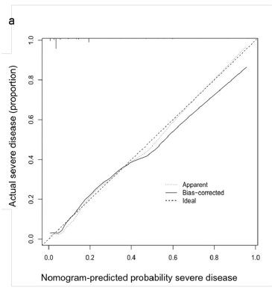
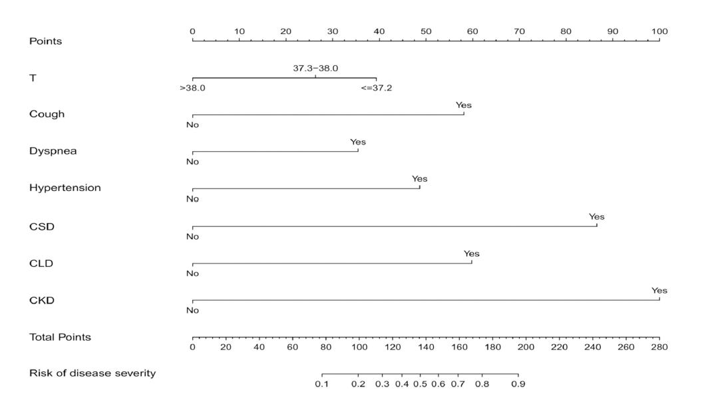
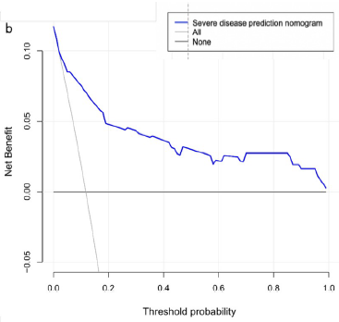
FEATURE SELECTION
VALIDATION & PERFORMANCE
24 (initial) 7
Seven predictors identified:
Body temperature at admission
Cough
Dyspnea
Hypertension
Cardiovascular disease
Chronic liver disease
Chronic kidney disease
Internal validation using bootstrapping (1000 replicates)
C-index: 0.863 (95% CI: 0.801-0.925)
Bootstrap validated C-index: 0.839
AUC: 0.862
Calibration plot used to assess reliability (a)
Decision curve analysis showed clinical utility (b)

Slide 6
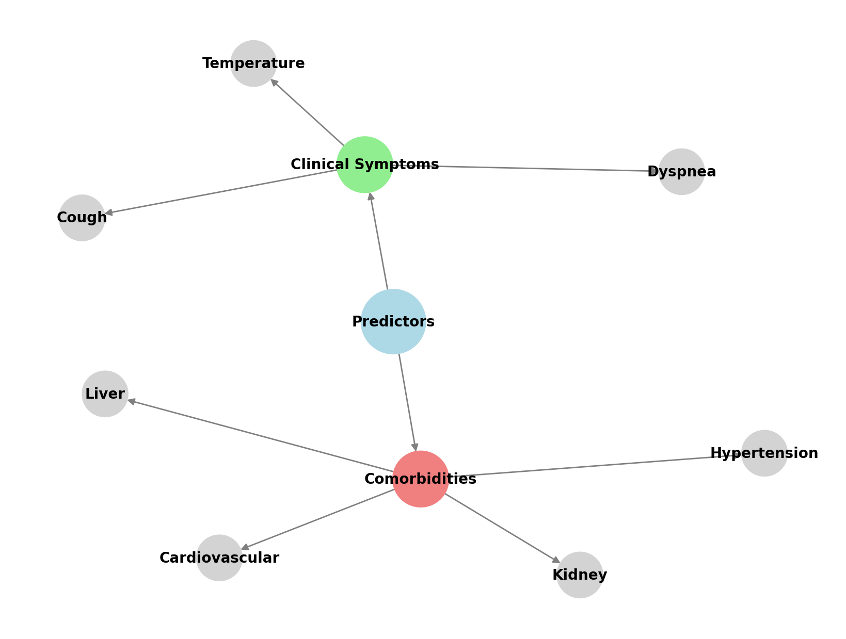
Key Takeaways: COVID-19 Severity Prediction Model
Predictors :
7 key predictors identified :
A combination of clinical symptoms and comorbidities may enhance the predictive accuracy of clinical models [4]
Model Performance:
C-index: 0.863 (95% CI: 0.801-0.925)
Bootstrap C-index: 0.839
AUC: 0.862
Clinical Value:
Early risk assessment tool
Strong predictor: Comorbidities
N = 366 (323 mild, 43 severe)

Slide 7
Study Strengths
Multicenter Study:
Data collected from 47 locations in Sichuan
Written informed consent and ethical approval obtained
Results are highly generalisable for that province [6]
LASSO Regression
Advanced variable selection reduced 24 potential predictors to 7 key features
Greater predictive performance of penalised logistic regression compared to logistic regression
Simpler, more interpretable model, preventing overfitting and optimism bias [7]
Model Validation and Performance :
Bootstrapping (1,000 resamples)
Discrimination and calibration
Decision Curve Analysis (DCA)
Quantified optimism in predictive performance and demonstrated net clinical benefit [8]

Slide 8
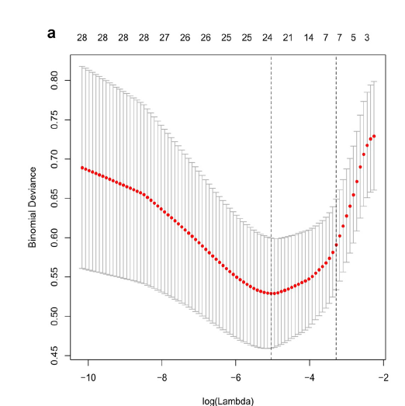

Study Strengths
Appropriate Lambda Selection Strategy: Prioritising Model Parsimony
Rigorous LASSO optimisation using five-fold cross-validation with two lambda selection criteria (minimum and 1-SE (standard error) rule)
Reduces overfitting by testing λ on multiple train-test splits instead of a single dataset.
Ensures the model generalises better to unseen data
This ensures robust feature selection and model stability by systematically determining the optimal level of regularisation [9].
Final Model is Parsimonious → Fewer predictors, same performance. Less risk of overfitting

Slide 9
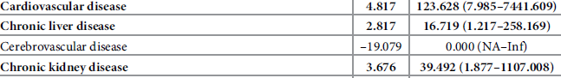
Study Limitations and Implications
Sample Size
Sample size: 366 patients
Only 43 events
Class imbalance: severe vs. mild cases ~1:7 ratio
EPV = 6.14 (below recommended 10) [10]
Implication: High risk of overfitting, limited generalisability, and a miscalibrated model, reducing clinical utility [11]
Geographic Coverage
• 47 locations in Sichuan province only
• 1 out of 23 provinces (4.3% coverage)
Implication: Limited external validity: an overfitted "Sichuan-specific" predictor [4]

Slide 10
Study Limitations and Implications
Data Collection Method
• Missing data obtained through direct communication
• Non-standardised data completion process
• Reliance on recall and manual intervention
Implication: Potential recall bias, inconsistent data quality, reduced reproducibility of findings [8]
Unclear Handling of Undischarged Patients' Outcomes
No details are provided on how these patients were handled in the analysis.
If they were excluded?
Were the classified as non-severe?
No time to event analysis
Implication: Potential misclassification of disease severity, leading to underestimated risk factors and bias in predicting disease progression. [12]

Slide 11
Study Limitations and Implications
Lambda parameter Justfication
No clear reporting of the criteria they have chosen to minimise
Choice of minimum or 1SE
Rationale for choosing minimum or 1 SE
Implication: Lack of transparency in feature selection makes it difficult to verify model reproducibility[12]
Forward Stepwise Selection following LASSO
No clear rationale
Stepwise selection highly sensitive to small dataset changes
Stepwise selection artificially inflates regression coefficients
Implication: Negates LASSO's intended regularisation benefits, leading to potential overfitting and unstable feature selection [13]

Slide 12
Study Limitations and Implications
Model Validation Limitations
•Bootstrapping after LASSO doesn't correct selection bias
• Same dataset used for LASSO selection and bootstrapping
• High performance metrics (C-index=0.863, AUC=0.862) likely inflated
• No external validation in independent patient populations
Implication: Overoptimistic performance estimates and unverified generalisability, lacking validation of model reproducibility and predictor stability [14]
How reliable are these results ?

Slide 13
Reliability and Recommendations
How reliable are these results?
Potential optimistic bias in performance estimates.
Recommendations
Increase sample size
Combine Individual participant data from multiple centers across China provinces [12]
Mixed-effects Cox model with LASSO penalty [6,12]
Bootstrapping prior to LASSO regression [14]
Apply data imputation methods
External validation [14]

Slide 14
References
1. Shakeel SM, Kumar NS, Madalli PP, Srinivasaiah R, Swamy DR. COVID-19 prediction models: a systematic literature review. Osong Public Health Res Perspect. 2021 Aug 31;12(4):215–29.
2. Du J, Lang H mei, Ma Y, Chen A wen, Qin Y yi, Zhang X ping, et al. Global trends in COVID-19 incidence and case fatality rates (2019–2023): a retrospective analysis. Front Public Health. 2024 Jul 29;12:1355097.
3. Li X, Wang X, Liu J, Huang G, Shi X. Epidemiological characteristics of confirmed COVID-19 in Guizhou province, China. Disaster Med Public Health Prep. 2020 Dec;14(6):769–75.
4. Schwab P, DuMont Schütte A, Dietz B, Bauer S. Clinical Predictive Models for COVID-19: Systematic Study. J Med Internet Res. 2020 Oct 6;22(10):e21439.
5. Zhou Y, He Y, Yang H, Yu H, Wang T, Chen Z, et al. Development and validation a nomogram for predicting the risk of severe COVID-19: A multi-center study in Sichuan, China. Taniyama Y, editor. PLOS ONE. 2020 May 18;15(5):e0233328.
6. Wynants L, Van Huffel S, Van Calster B. Prediction models in multicenter studies: methodological aspects and current state of the art. Arch Public Health. 2015 Dec;73(S1):O3.
7. Ranstam J, Cook JA. LASSO regression. Br J Surg. 2018 Aug 7;105(10):1348–1348.
8. Collins GS, Reitsma JB, Altman DG, Moons K. Transparent reporting of a multivariable prediction model for individual prognosis or diagnosis (TRIPOD): the TRIPOD Statement. BMC Med. 2015;13(1):1.
9. Friedrich S, Groll A, Ickstadt K, Kneib T, Pauly M, Rahnenführer J, et al. Regularization approaches in clinical biostatistics: A review of methods and their applications. Stat Methods Med Res. 2023 Feb;32(2):425–40.
10. Van Den Goorbergh R, Van Smeden M, Timmerman D, Van Calster B. The harm of class imbalance corrections for risk prediction models: illustration and simulation using logistic regression. J Am Med Inform Assoc. 2022 Aug 16;29(9):1525–34.
11. Van Smeden M, Moons KG, De Groot JA, Collins GS, Altman DG, Eijkemans MJ, et al. Sample size for binary logistic prediction models: Beyond events per variable criteria. Stat Methods Med Res. 2019 Aug;28(8):2455–74.
12. Wynants L, Van Calster B, Collins GS, Riley RD, Heinze G, Schuit E, et al. Prediction models for diagnosis and prognosis of covid-19: systematic review and critical appraisal. BMJ. 2020 Apr 7;m1328
13. Smith G. Step away from stepwise. J Big Data. 2018 Dec;5(1):32.
14. Collins GS, Dhiman P, Ma J, Schlussel MM, Archer L, Van Calster B, et al. Evaluation of clinical prediction models (part 1): from development to external validation. BMJ. 2024 Jan 8;e074819.

